Slide 1

Phishing
ASHWINI PALANDE

Slide 2

WHAT IS PHISHING
Phishing is a type of cybercrime in which attackers impersonate trusted entities—such as banks, companies, or coworkers—through fraudulent emails, text messages, or websites to manipulate individuals into revealing sensitive information or downloading malicious files. The attacker’s goal is to steal credentials, personal or financial details, or install malware on the victim’s device.
ASHWINI PALANDE

Slide 3
tyPES OF
PHISHING
1. Email Phishing
Mass-emailed fraudulent messages pretending to originate from trusted organizations, such as banks or delivery companies. They often contain links or attachments prompting credential theft or malware downloads.
2. Spear Phishing
Highly targeted phishing aimed at a specific individual or organization. Attackers research their victims to craft convincing messages that appear safe and legitimate.
3. Whaling (Whale Phishing)
A form of spear phishing targeting top executives or high-profile individuals. Because of the potential access to sensitive data or funds, whaling often involves sophisticated social engineering and sense of urgency.
ASHWINI PALANDE

Slide 4
tyPES OF
PHISHING
4. Business Email Compromise (BEC)
A typically spear or whaling-style attack where cybercriminals impersonate or compromise a legitimate email account to trick employees into sharing confidential info or transferring funds.
5. Smishing (SMS Phishing)
Phishing via SMS or text message. Victims receive urgent messages—e.g., pretending to be from a courier or bank—encouraging them to click links or reply with personal data.
6. Vishing (Voice Phishing)
Phishing through phone calls (landline or VoIP), often using caller ID spoofing and emotional manipulation to obtain sensitive info like bank details or account credentials.
ASHWINI PALANDE

Slide 5
tyPES OF
PHISHING
7. Pharming
Victims are redirected—even if they type the correct URL—to a fake website via DNS manipulation or malware. Once on the spoofed site, they unknowingly enter sensitive information.
8. Angler Phishing (Social Media Phishing)
Attackers impersonate support accounts or create fraudulent social media profiles to solicit sensitive information from users via DMs, comments, or fake posts.
9. Clone Phishing
An attacker duplicates a previously legitimate email (e.g., from a known sender) but replaces links or attachments with malicious versions, then resends them to the victim.
ASHWINI PALANDE

Slide 6
tyPES OF
PHISHING
10. Man‑in‑the‑Middle (MitM) Phishing
Advanced phishing where a hacker intercepts communication between a user and legitimate site—often bypassing 2FA—by manipulating sessions or relaying credentials in real time.
11. Quishing (QR Code Phishing)
Phishing via malicious QR codes that redirect users to fraudulent sites or triggers downloads of malware. Common in physical ads or digital communications.
ASHWINI PALANDE

Slide 7
example
Subject: “Your Bank Account is Suspended”
Email from: support@bankofarnerica.com
Link: http://login.bankofarnerica.com/reset ← (note the misspelling)
ASHWINI PALANDE

Slide 8
HOW TO IDENTIFY A PHISHING ATTACK
Phishing attacks are designed to appear trustworthy while concealing malicious intent. The following red flags will help users spot and avoid these attacks.
1. Suspicious Sender Address
Phishing emails often come from addresses that look similar to official ones but have subtle errors:
security@paypa1.com instead of security@paypal.com
no-reply@micros0ft.support instead of no-reply@microsoft.com
Look closely at domain names — attackers may swap characters (o with 0, l with 1) or add extra subdomains (support-secure-login.bank.com.fakeurl.net).
2. Generic Greetings & Language
Legitimate companies usually personalize messages using your real name or account details.
Phishing Example:
Dear Valued Customer, your account is at risk.
Legitimate Example:
Hi Alex, we've noticed unusual activity in your account ending in 1234.
ASHWINI PALANDE

Slide 9
HOW TO IDENTIFY A PHISHING ATTACK
3. Urgent or Threatening Language
Phishing messages frequently use pressure tactics to push you into quick action.
Common scare phrases:
Your account will be deactivated in 24 hours.
Unusual login detected—verify now!
Final warning: Pay your invoice immediately!
4. Unexpected Attachments or Links
Emails with unfamiliar attachments (such as PDFs, ZIP files, or Word documents) or links requesting credentials are highly suspicious.
Hover over the link to see the actual URL (e.g., http://secure-your-bank.com is likely fake).
Attachments may contain malware, ransomware, or hidden macros.
ASHWINI PALANDE

Slide 10
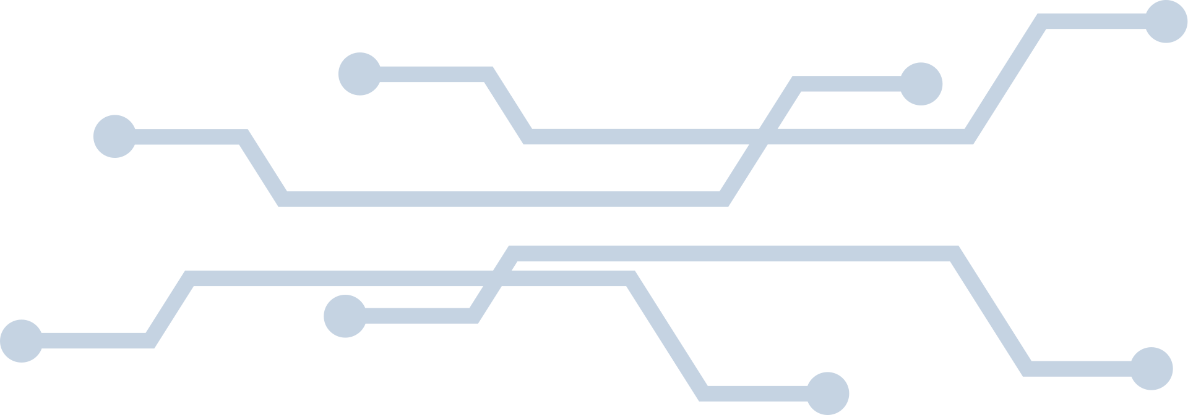
REAL-LIFE
EXAMPLE
Google Docs Phishing (2017)
Summary:
A highly sophisticated phishing campaign spread across Gmail.
Victims received an email saying someone shared a Google Doc with them.
The link led to a fake Google login page (with real branding).
It requested access to the user’s Gmail account, then spread itself further by auto-sending to contacts.
Impact:
Affected millions of users in under an hour.
Gave attackers access to emails, contacts, and sensitive data.
Key Lesson:
Even familiar services like Google can be mimicked convincingly. Always verify the sender and check the app’s permissions.
ASHWINI PALANDE

Slide 11
practices and tips to avoid falling a victim to phishing
1. Be Skeptical of Urgent or Threatening Language
Phishing emails often try to create panic (“Your account will be locked!”).
Don’t rush—pause and verify the message.
2. Verify Sender Email Addresses Carefully
Phishers often use addresses that look similar to legitimate ones (e.g., support@amaz0n.com).
Hover over the address or click details to check the actual sender.
3. Don’t Click on Suspicious Links
Hover over links to preview the URL.
If the domain doesn’t match the legitimate company site, don’t click.
4. Avoid Downloading Unexpected Attachments
Phishing messages may contain malicious attachments (.exe, .docm, .zip).
If you weren’t expecting an attachment—even from someone you know—verify first.
ASHWINI PALANDE

Slide 12
practices and tips to avoid falling a victim to phishing
5. Enable Multi-Factor Authentication (MFA)
Even if credentials are stolen, MFA adds an extra layer of security.
6. Use Strong, Unique Passwords
Don’t reuse passwords across sites.
Use a password manager to generate and store them securely.
7. Keep Software and Systems Updated
Phishers exploit known vulnerabilities.
Regular updates patch security flaws in browsers, OS, and email clients.
8. Educate Yourself and Others
Stay informed about phishing techniques (spear phishing, clone phishing, etc.).
Encourage ongoing cybersecurity training in the workplace.
ASHWINI PALANDE

Slide 13
Thank You
ASHWINI PALANDE

